Slide 1

Dependency Parsing

Slide 2
Contents
Introduction to Dependency Parsing
Dependency Relations
Dependency Trees
Types of Dependency Parsing
Transition-based Dependency Parsing
Graph-based Dependency Parsing
Evaluation Metrics

Slide 3
Introduction to Dependency Parsing
Dependency parsing is a process in natural language processing that involves analyzing the grammatical structure of a sentence by identifying the relationships between words.
These relationships are based on the syntactic dependencies that exist between words, indicating how words are connected and how they function within the sentence's structure.

Slide 4
Introduction to Dependency Parsing
Directed Graph Representation
  Dependency parsing portrays sentence structure via a graph called a dependency tree. Each word becomes a node, linked by directed edges to depict relationships.
  Graph nodes match words, while edges show syntactic dependencies. Labels on edges specify relationship types, like "subject" or "object," revealing roles and connections between sentence words.

Slide 5
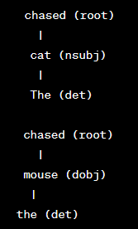
Introduction to Dependency Parsing
Example
  Consider the sentence "The cat chased the mouse." The dependency parsing process might result in the following dependency graph
In this example:
The word "chased" is the root of the sentence, indicating that it is the main verb.
The word "cat" is the subject (nsubj) of the verb "chased."
The word "mouse" is the direct object (dobj) of the verb "chased."
The word "The" and "the" are determiners (det) associated with "cat" and "mouse," respectively.

Slide 6
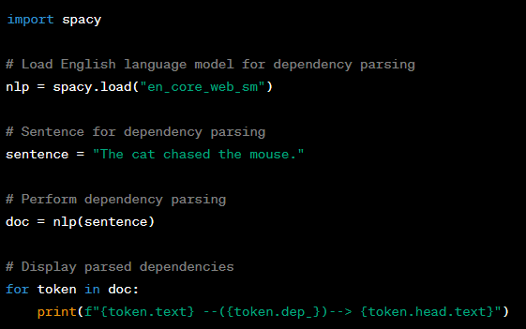
Introduction to Dependency Parsing
Python implementation
We use the spacy library to perform dependency parsing.
We load the English language model for dependency parsing using spacy.load("en_core_web_sm").
We provide a sentence for dependency parsing.
The nlp object processes the sentence, and each token in the sentence is annotated with its dependency relation to its head token.
We loop through the tokens and print out their text, dependency relation, and head text to visualize the dependency tree.

Slide 7
Dependency Relations
Dependency relations are the grammatical and syntactic relationships that exist between words in a sentence.
These relationships are represented using dependency edges in a dependency tree or graph, which provide insights into how words are connected and how they function within the sentence's structure.

Slide 8
Dependency Relations
Key Points about Dependency Relations
  Connecting Words
    Dependency edges connect individual words (nodes) in the sentence. Each word is a node, and the edges establish links between them to indicate their relationships.
  Directed Edges
    The edges are directed, meaning they have a specific direction. The direction of an edge points from one word (the governor) to another word (the dependent), reflecting the relationship between them.
  Grammatical Relationships
    Each dependency edge represents a specific grammatical relationship between the words connected by the edge. These relationships describe how words function within the sentence and how they contribute to its overall meaning.

Slide 9
Dependency Relations
Key Points about Dependency Relations
  Types of Dependency Relations
    There are various types of dependency relations that correspond to different grammatical roles and functions. Some common dependency labels include
    nsubj (Nominal Subject) : The word that performs the action of the main verb.
    dobj (Direct Object) : The word that receives the action of the verb.
    amod (Adjectival Modifier) : An adjective that modifies a noun.
    advmod (Adverbial Modifier) : An adverb that modifies a verb, adjective, or other adverb.
    prep (Prepositional Modifier) : A preposition followed by its object.

Slide 10
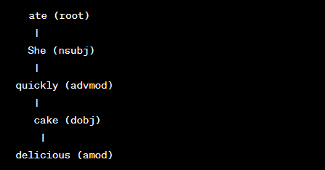
Dependency Relations
Example
  Consider the sentence "She quickly ate the delicious cake." The dependency relations can be represented as follows
  In this example, "ate" is the main verb (root), "She" is the subject (nsubj), "quickly" is an adverbial modifier (advmod) of "ate," "cake" is the direct object (dobj) of "ate," and "delicious" is an adjectival modifier (amod) of "cake."

Slide 11
Dependency Trees
A dependency tree is a graphical representation of the syntactic structure of a sentence that captures the grammatical relationships and dependencies between words.
It is a type of directed graph where each word in the sentence is represented as a node, and the relationships between words are represented as directed edges connecting the nodes.

Slide 12
Dependency Trees
Key Features of a Dependency Tree
  Node Representation
    Each word in the sentence corresponds to a node in the dependency tree. These nodes are typically labeled with the word itself.
  Directed Edges
    The edges in the dependency tree are directed, indicating the dependency relations between words. Each edge points from one word (the governor) to another word (the dependent).
  Root Node
    The root of the dependency tree represents the main predicate or the primary action of the sentence. It is the word that does not depend on any other word in the sentence.
  Dependency Labels
    The edges in the dependency tree are labeled with dependency labels that describe the specific grammatical relationship between the connected words.

Slide 13
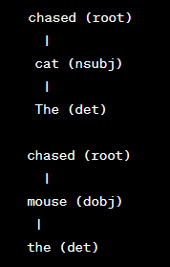
Dependency Trees
Example Dependency Tree
  Consider the sentence "The cat chased the mouse." The corresponding dependency tree could be represented as follows:
In this example
"chased" is the main predicate (root),
"cat" is the nominal subject (nsubj) of "chased,"
"The" is a determiner (det) that modifies "cat.“
Similarly,
"mouse" is the direct object (dobj) of "chased,"
"the" is a determiner (det) that modifies "mouse."

Slide 14
Types of Dependency Parsing
Dependency parsing, the process of analyzing the grammatical structure of a sentence, can be categorized into two main types based on how the relationships between words are represented:
Projective Parsing
Non-Projective Parsing

Slide 15

Types of Dependency Parsing
Projective Parsing
  Projective parsing involves constructing a dependency tree where the edges do not cross or intersect.
  In other words, the tree is drawn in such a way that no two edges overlap each other.
  This type of parsing is simpler and more intuitive, making it easier to visualize the relationships between words.
  Example of a Projective Dependency Tree
    Consider the sentence "The cat chased the mouse."
    A projective dependency tree for this sentence would look like this:

Slide 16

Types of Dependency Parsing
Non-Projective Parsing
  Non-projective parsing allows for edges to cross or intersect in the dependency tree.
  This means that the relationships between words can be more complex and capture subtle syntactic interactions that might not be possible to represent using only projective trees.
  Non-projective parsing is better suited for languages with more flexible word orders and complex sentence structures.
  Example of a Non-Projective Dependency Tree
    For the sentence "The cat chased the mouse,"
    a non-projective dependency tree might look like this:
    In this non-projective tree, the edge between "cat"
    and "The" crosses the edge between "chased" and "The,"
    allowing for a different representation of the relationships.

Slide 17
Transition-based Dependency Parsing
Transition-based parsing is a common approach to dependency parsing that involves sequentially applying a series of transition rules to construct a dependency tree for a given sentence.
This approach treats dependency parsing as a sequence of actions, where each action corresponds to a manipulation of the parsing state, eventually leading to the construction of the entire tree.

Slide 18
Transition-based Dependency Parsing
Key Features of Transition-Based Parsing
  Parsing State
    The parsing process maintains a parsing state that represents the current state of the dependency tree being constructed.
  Transition Rules
    Transition rules are predefined actions that can be applied to the parsing state to move it closer to the final dependency tree. These rules are designed to imitate how a human might intuitively build a sentence's structure.
  Action Sequence
    The transition-based parser applies a sequence of transition rules to the parsing state, gradually transforming it into a fully formed dependency tree.

Slide 19
Transition-based Dependency Parsing
Common Transition Actions
  Shift
    The shift action moves the next word from the input sentence to the stack in the parsing state. This action is used when a word is not yet part of any dependency relationship.
  Reduce
    The reduce action removes a word from the stack, indicating that it has been incorporated into the dependency tree.
  Left-Arc
    The left-arc action creates a dependency edge from the current word to the top word on the stack, then pops the top word from the stack.
  Right-Arc
    The right-arc action creates a dependency edge from the top word on the stack to the current word, then pushes the current word onto the stack.

Slide 20
Transition-based Dependency Parsing
Example Transition Sequence
  Let's consider the sentence "The cat chased the mouse." Here's a simplified example of the transition-based parsing process:
    Shift: "The" is shifted onto the stack.
    Shift: "cat" is shifted onto the stack.
    Left-Arc: A left-arc is applied, creating a dependency edge from "The" to "cat" and popping "The" from the stack.
    Shift: "chased" is shifted onto the stack.
    Shift: "the" is shifted onto the stack.
    Right-Arc: A right-arc is applied, creating a dependency edge from "chased" to "the" and pushing "the" onto the stack.
    Shift: "mouse" is shifted onto the stack.
    Left-Arc: A left-arc is applied, creating a dependency edge from "chased" to "mouse" and popping "chased" from the stack.

Slide 21
Graph-based Dependency Parsing
Graph-based parsing is an alternative approach to dependency parsing that views the task of constructing a dependency tree as a graph optimization problem.
In this approach, the goal is to find the best possible graph structure that satisfies certain constraints and assigns appropriate labels to the nodes and edges.

Slide 22
Graph-based Dependency Parsing
Key Features of Graph-Based Parsing:
  Graph Representation
    Instead of constructing a dependency tree step by step, graph-based parsing represents the entire parsing process as a graph. The nodes of the graph correspond to words in the sentence, and the edges represent potential dependencies between words.
  Optimization Objective
    The parsing process is formulated as an optimization problem, where the objective is to find the best possible graph structure that maximizes a certain scoring function. This function takes into account both the constraints and the likelihood of the observed linguistic features.
  Labels and Constraints
    Graph-based parsing assigns labels to nodes and edges in the graph to represent grammatical roles and relationships. Constraints ensure that the graph adheres to valid linguistic structures.

Slide 23
Graph-based Dependency Parsing
Example:
  Let's consider the sentence "The cat chased the mouse."
  Represent the sentence as a graph and assign labels to the nodes (words) and edges (dependencies) based on observed linguistic features.
  The goal is to find the best graph structure that adheres to linguistic constraints and maximizes a scoring function.

Slide 24

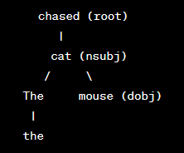
Graph-based Dependency Parsing
Example:
  Graph Representation
  Parsing Process
    Assign labels to nodes: We label the nodes with words ("The," "cat," "chased," "the," "mouse").
    Assign edges: We start by considering all possible edges between nodes. For instance, we consider "chased" as the root, and we explore edges to connect "The," "cat," and "the" to "chased." We also consider edges from "chased" to "mouse."
    Score computation: We calculate scores for each potential edge based on our scoring function. For example, we might give higher scores to edges connecting "chased" to "cat" (subject relationship) and "chased" to "mouse" (object relationship).
    Optimization: We aim to find the best graph structure that maximizes the total score while adhering to linguistic constraints. We might use techniques like dynamic programming to efficiently search for the best structure.
  Best Graph Structure
In this example, the graph-based parsing approach has successfully captured the relationships between words "The," "cat," "chased," "the," and "mouse," assigning appropriate labels and constructing a coherent dependency structure.

Slide 25
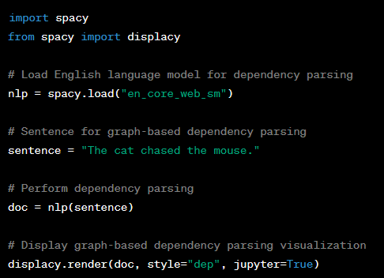
Graph-based Dependency Parsing
Python Implementation
We use the spacy library to perform graph-based dependency parsing.
We load the English language model for dependency parsing using spacy.load("en_core_web_sm").
We provide a sentence for dependency parsing.
The nlp object processes the sentence and annotates each token with its dependency relation and head.
We use the displacy.render function to visualize the graph-based dependency parsing result using the "dep" style.

Slide 26
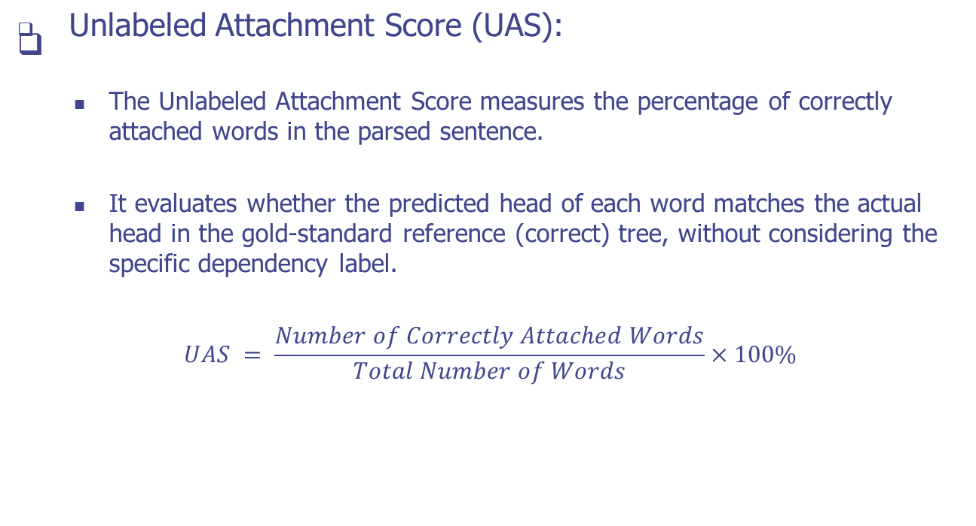
Evaluation Metrics

Slide 27
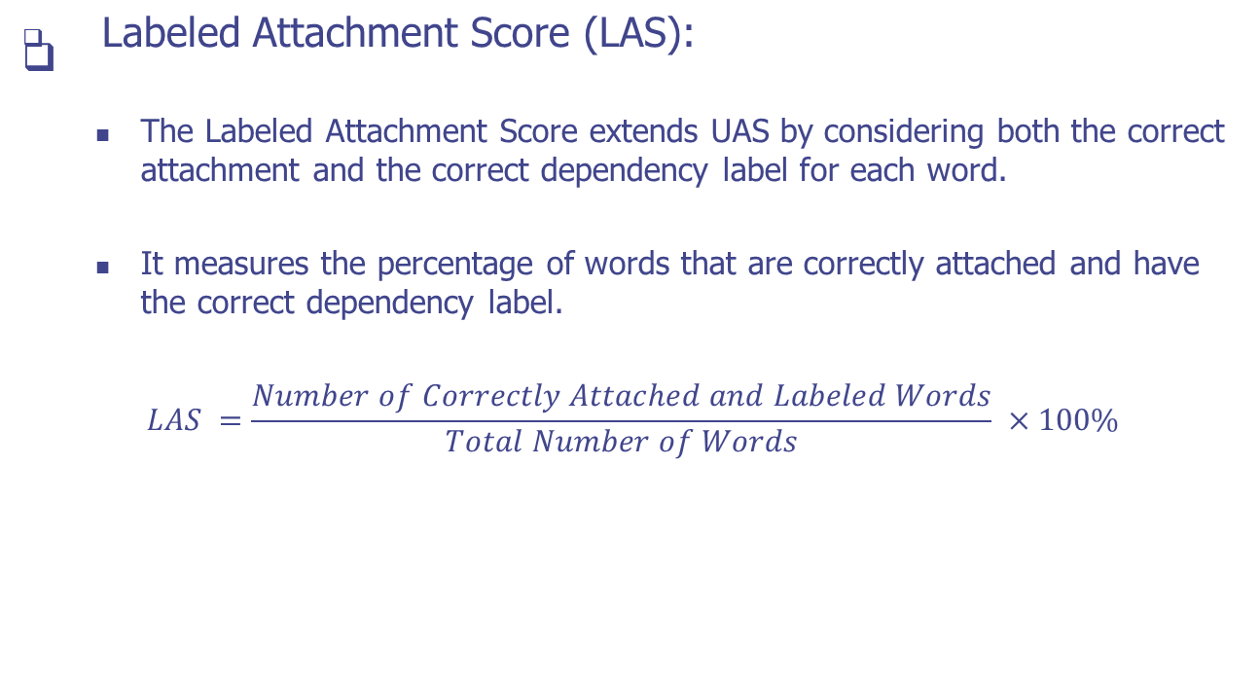
Evaluation Metrics

Slide 28
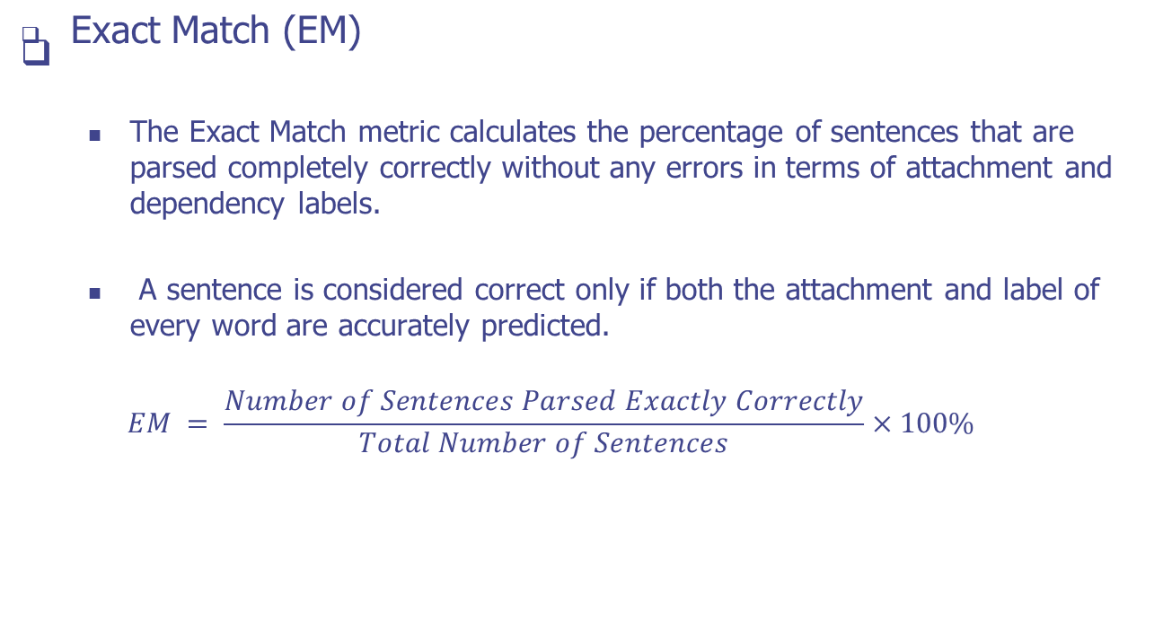
Evaluation Metrics

Slide 29
Q & A

